Slide 1
AI Capstone Project – Automatic Detection of Contrails From Flights
Image source: https://communitycc.com/wp-content/uploads/2020/01/Around-The-World-Icon-2.png
slides source: Esther Roosenbrand

Slide 2

Contrail (Persistence)
Non-Persistent
Persistent

Slide 3
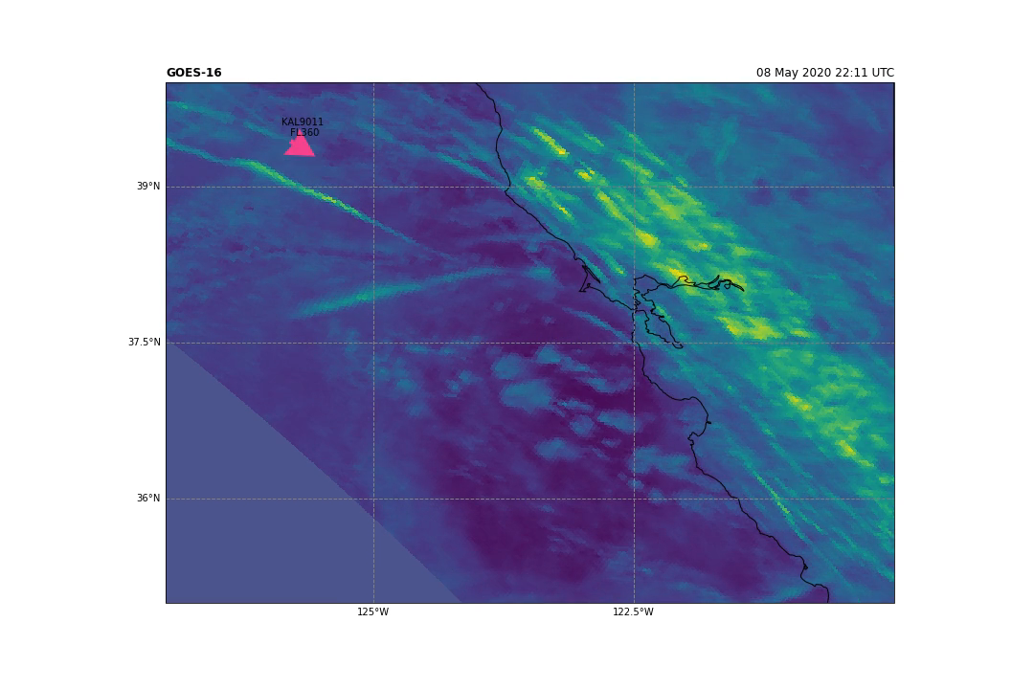
GOES & OpenSky (ADSB-Data)

Slide 4
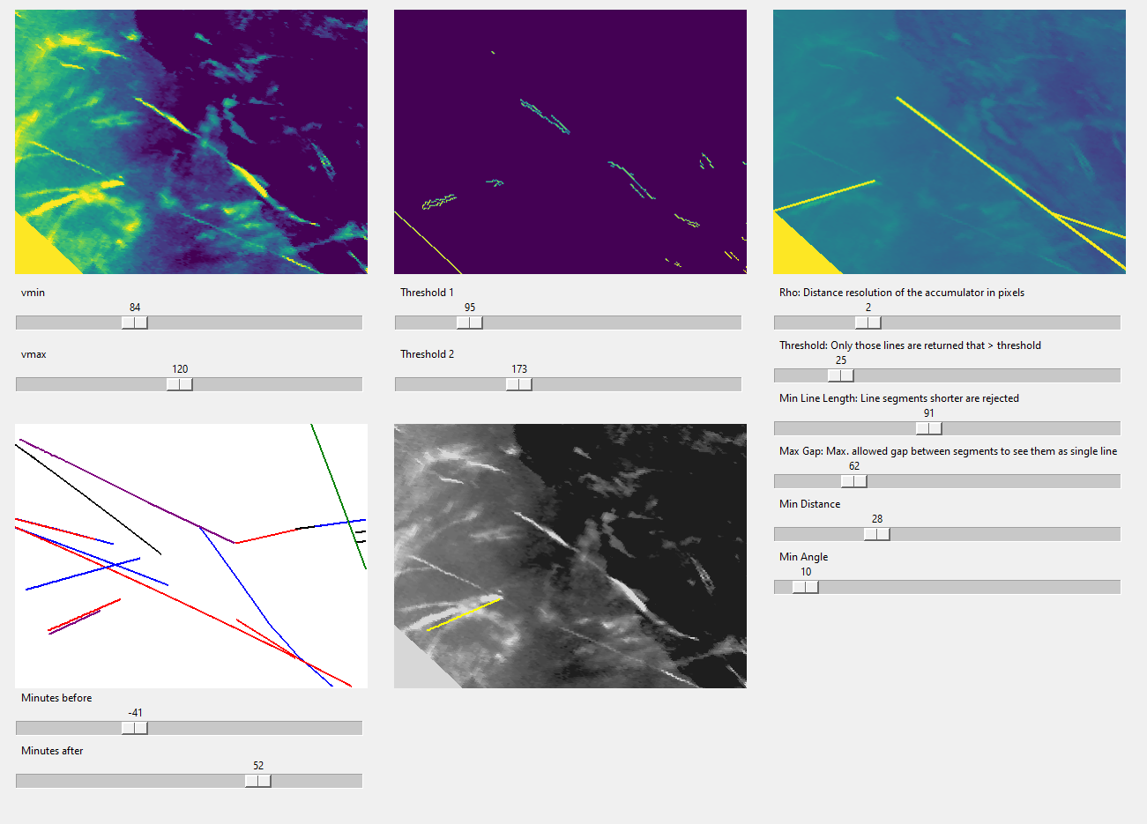
1. Colorbar contrast
2. Cv2.Canny (edges)
3. Cv2.HoughLineP
4. OpenSky (clickable)
5. Greyscale 1. + clicked 4

Slide 5

Context: Climate-optimized model
Climate impact of aircraft emissions significant
Wind-optimization ≠ climate optimization
Presence of high climate impact regions
Knowledge necessary:
Warming/cooling contrail-forming areas
Day & Night
Net warming-effect
Earth’s surface

Slide 6
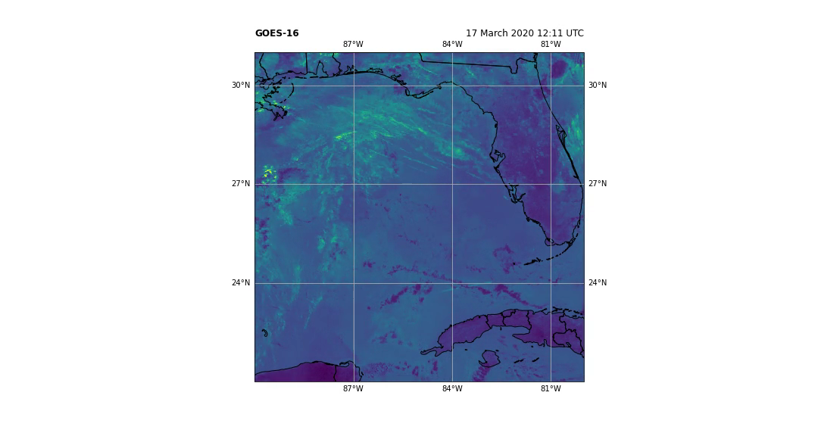
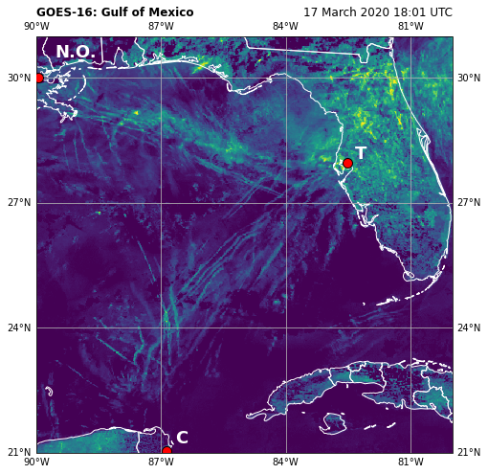
Remote Sensing Data: GOES-16, 17 and 18
IR bands (5 min and +0.5 -2 km res)

Slide 7
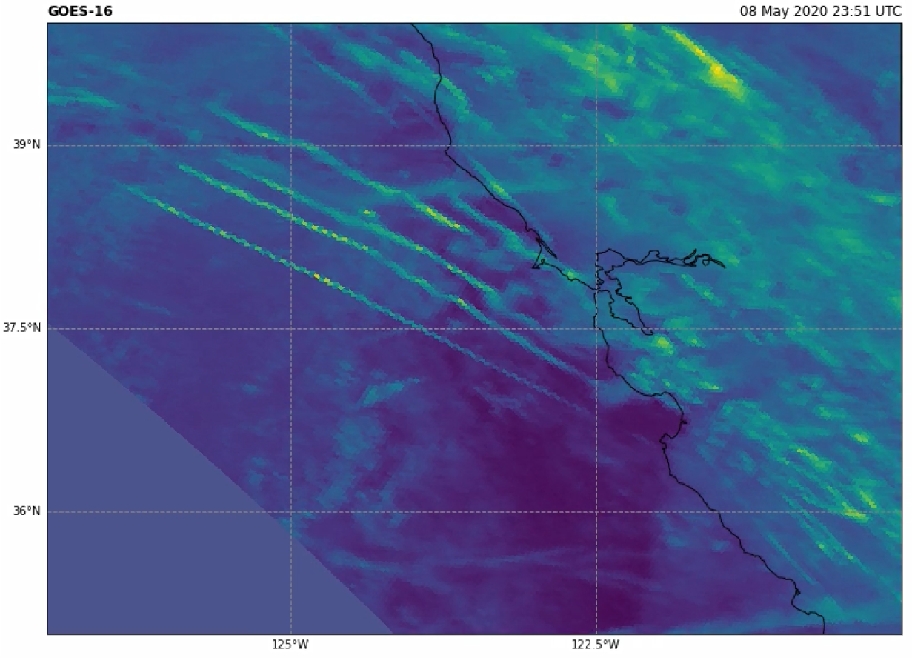
Goal: Contrail Detection from Sat Imagery

Slide 8
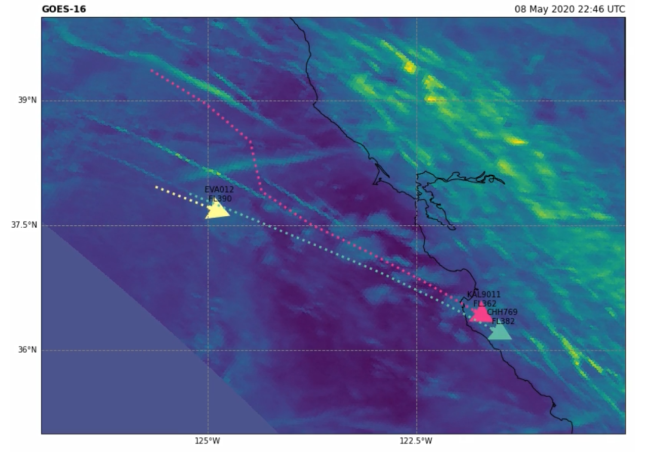
Goal: Bigger Picture
By linking contrail with flight, altitude is known -> atmospheric conditions
Persistence and width of contrail are also parameters of interest

Slide 9
Data pre-identified contrail days
GitHub GUI
- Semi-supervised labelling contrail tool
- Machine learning approaches to predict the presence of contrails
OpenSky trajectories (.csv)
~100 GOES-16 (.nc)
Input
Framework
Output

Slide 10
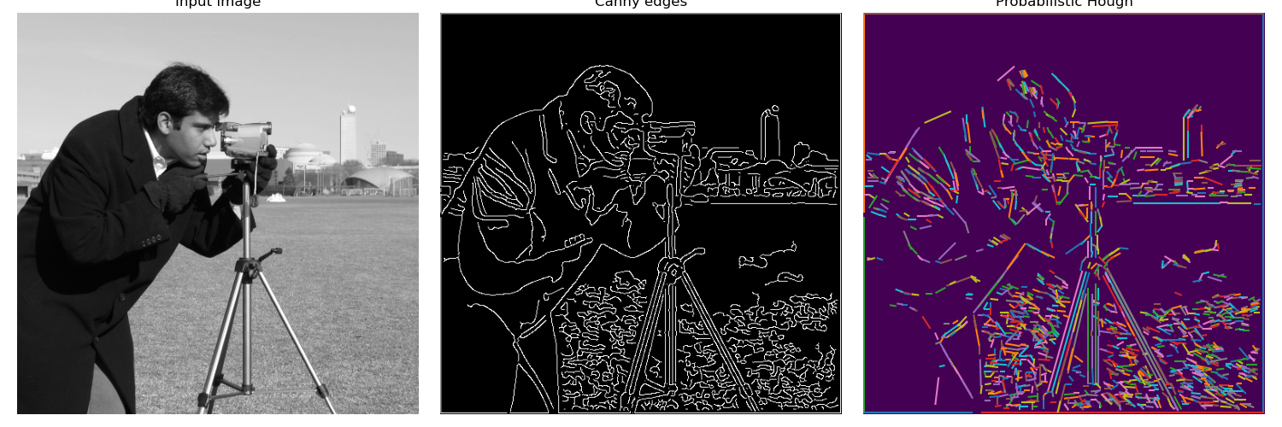
Currently used in GUI
OpenCV
Canny Edge Detector
Hough Line Transform
Input Image
Canny Edges
Probabilistic Hough

Slide 11
1. Colorbar contrast
2. Cv2.Canny (edges)
3. Cv2.HoughLineP
4. OpenSky (clickable)
5. Greyscale 1. + clicked 4

Slide 12
Moscow analysis
Must process given dataset to generate features related to contrails.
Must link a number of contrails with flight date to form a baseline training data set.
Must create a user interface for visualizing and labelling contrails.
Must identify the proper machine learning methods for the contrail identification.
Should provide metrics to evaluate the prediction performance.
Should provide visualizations and analysis for the models and results.
Could correlate predicted contrails with atmospheric data (e.g., ERA5).
Could be able to apply the tool word-wide.
Won’t need any high-performance computer (i.e. personal computer is sufficient).
Won’t collect real-time flight data.
Won’t need to use all the data provided.

Slide 13
References
Context:
Grewe, V., Matthes, S., Frömming, C., 2017. Feasibility of climate-optimized air traffic routing for trans-Atlantic flight
Rosenow, J., and Fricke, H., 2019. Individual Condensation Trails in Aircraft Trajectory Optimization
Wilhelm, L., Gierens, K., Rohs, S., 2022. Meteorological Conditions that Promote Persistent Contrails
Assessing and Modeling Climate Optimal Flights Using Open Surveillance and Remote Sensing Data. (10th ICRAT)
Examining Contrail Formation Models with Open Flight and Remote Sensing Data. (SESAR Innovation Days)
Examples Contrail detection:
Vazquez-Navarro, M., Mannstein, H., Mayer, B., 2010. An automatic contrail tracking algorithm
Gillian M. Whelan, G., Cawkwell, F., 2009. The use of Meteorological Data to Improve Contrail Detection in Thermal Imagery over Ireland.
Luke Kulik (MSc. Thesis AE TU Delft), 2016. Satellite-based detection of contrails using deep learning
Vazquez-Navarro, M., Mannstein, H., 2015. Contrail life cycle and properties from 1 year of MSG/SEVIRI rapid-scan images
McCloskey, K., and Geraedts, S., 2021. A human-labeled Landsat-8 contrails dataset.

